Slide 1
Introduction to Computer Vision (CS642)
Local Image Features - Lecture 05
Dr. Abdul Basit
Associate Professor - CS & IT University of Balochistan
June 22, 2026
Local Image Features

Slide 2





Contents
1
Feature Matching
What are Interest Points?
Interest point detection
Harris Interest Point Detector
Eigen Vectors and Eigen Values
Local Image Features

Slide 3
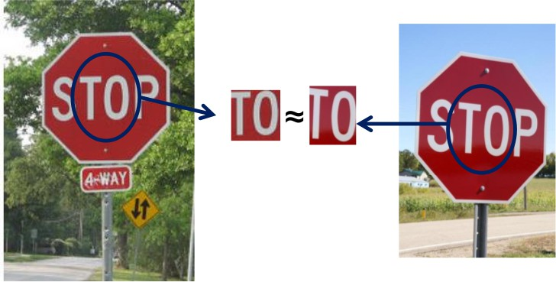
Feature Matching
Correspondence across views
Correspondence is the matching of points, patches, edges, or regions across the images.
Figure: Reprinted from
Local Image Features

Slide 4
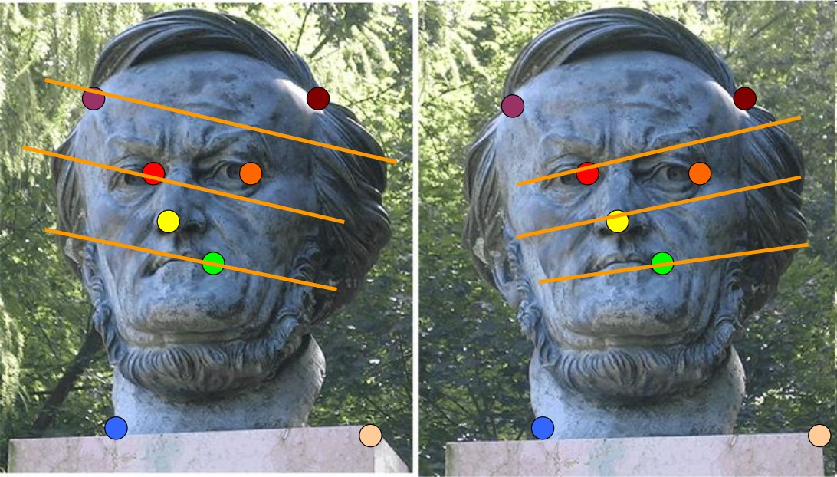
Feature Matching
Example: Fundamental Matrix
Estimating the fundamental matrix that corresponds two views.
Figure: Reprinted from
Local Image Features

Slide 5
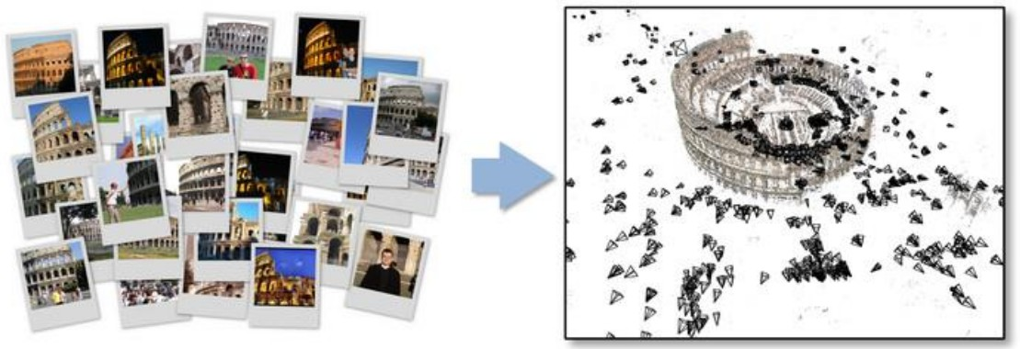
Feature Matching
Example: Structure from motion
Estimating the fundamental matrix that corresponds two views.
Figure: Reprinted from
Local Image Features

Slide 6


Contents
1
Feature Matching
What are Interest Points?
Interest point detection
Harris Interest Point Detector
Eigen Vectors and Eigen Values
Local Image Features

Slide 7
Interest points
Definition
Interest point is the well defined position in the image. Interest point is also called key points or features.
Applications:
Tracking: Which points are good to track?
Recognition: Find patches likely to tell us something about object category
3D reconstruction: Find correspondences across different views.
Local Image Features

Slide 8
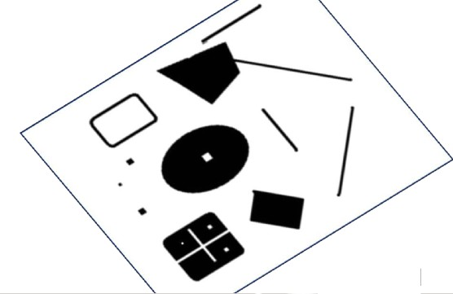
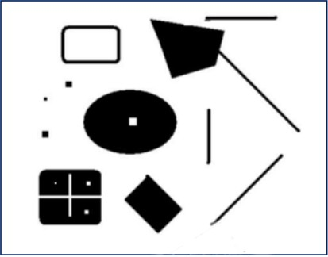
Interest points
What is feature?
What points are easier to remember in the image and recalled after the image is deformed.
Table: Points to remember in the deformed image
Local Image Features

Slide 9
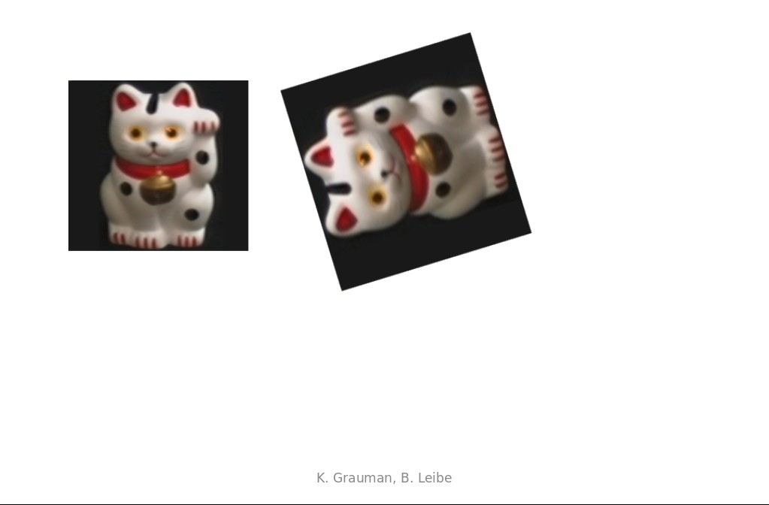
Interest points
Key point matching
Local Image Features

Slide 10
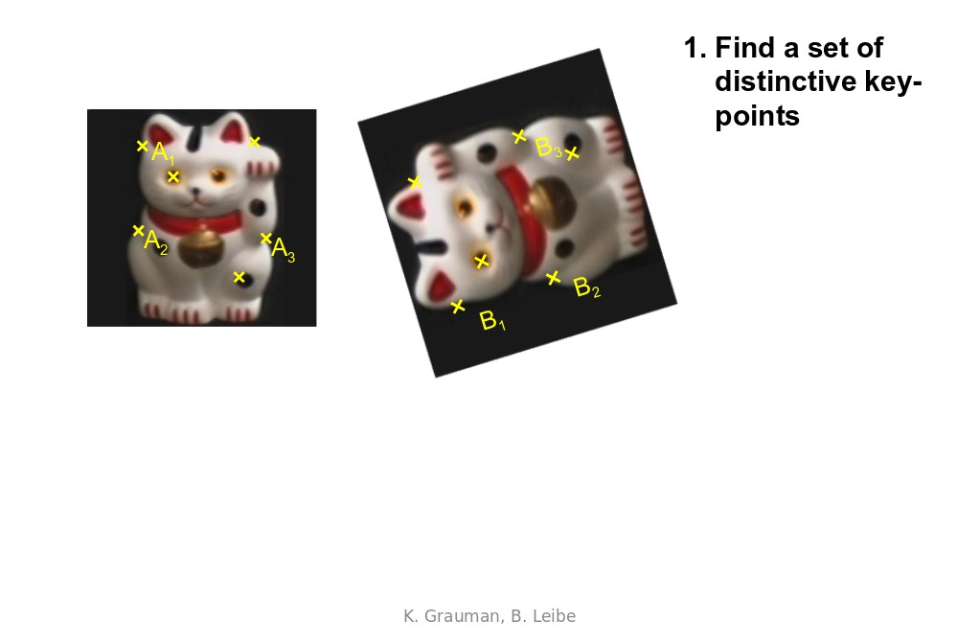
Interest points
Key point matching
Local Image Features

Slide 11
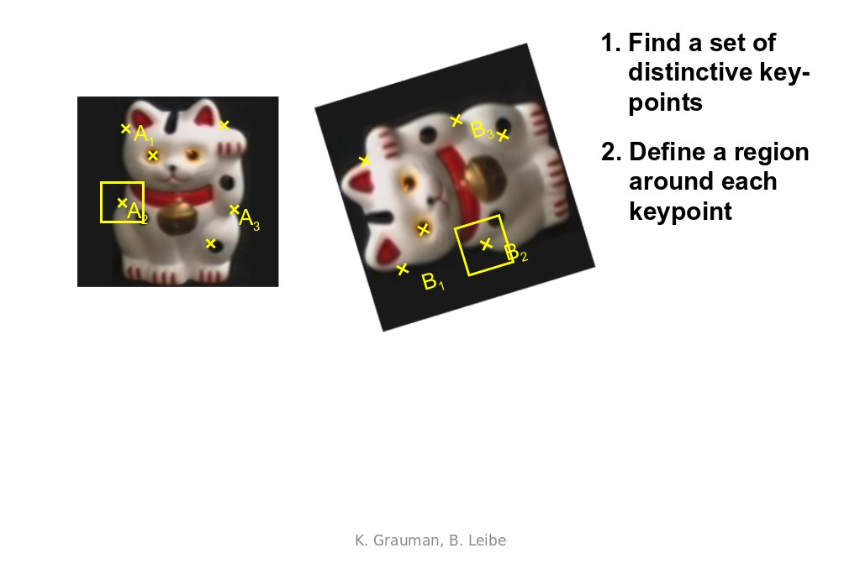
Interest points
Key point matching
Local Image Features

Slide 12
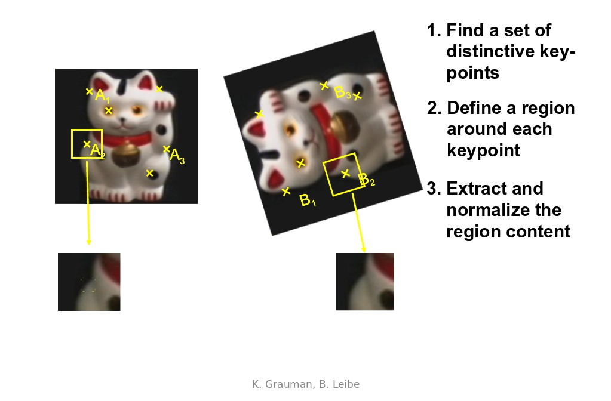
Interest points
Key point matching
Local Image Features

Slide 13
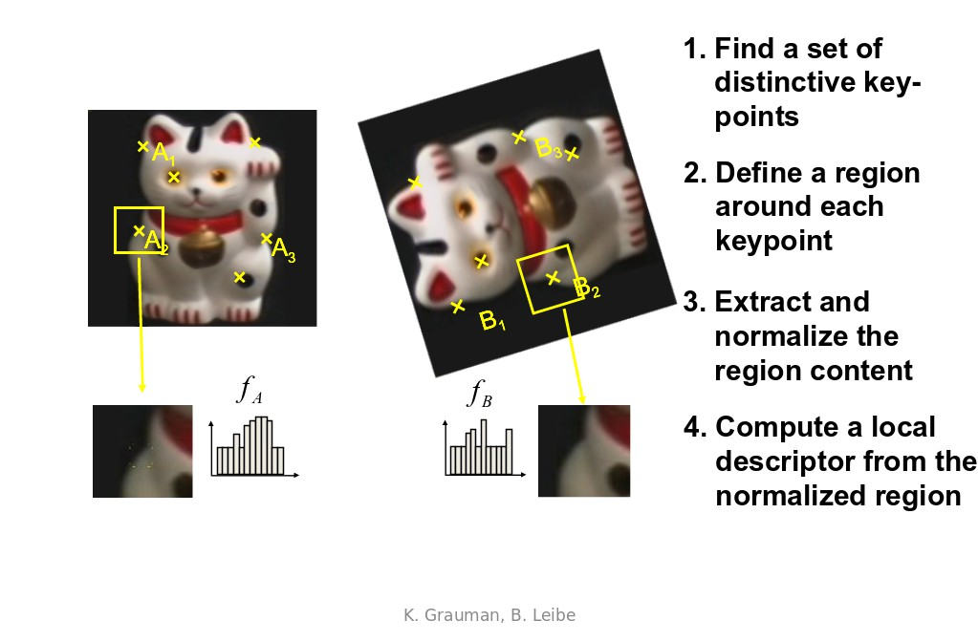
Interest points
Key point matching
Local Image Features

Slide 14
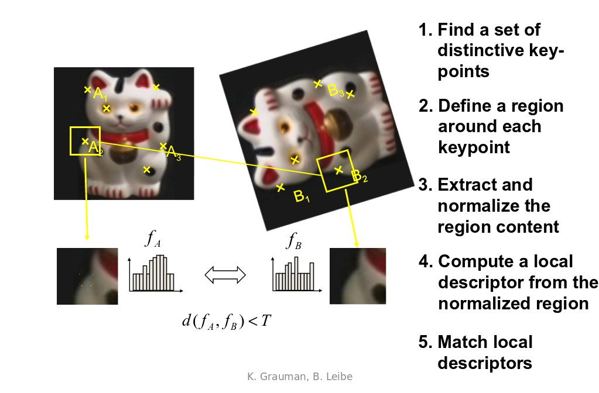
Interest points
Key point matching
Local Image Features

Slide 15
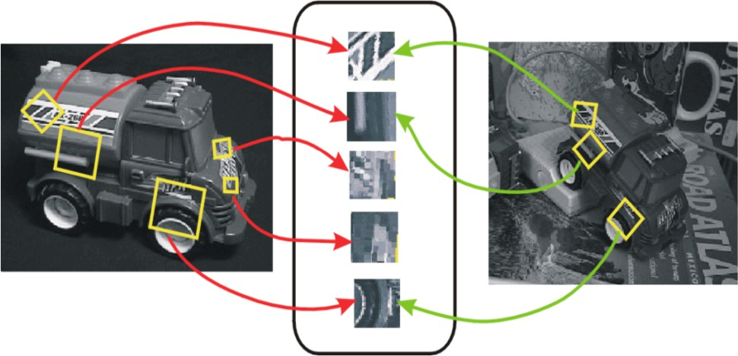
Interest points
Invariant Local Features
Image content is transformed into local feature coordinates that are invariant to translation, rotation, scale, and other imaging parameters
Local Image Features

Slide 16
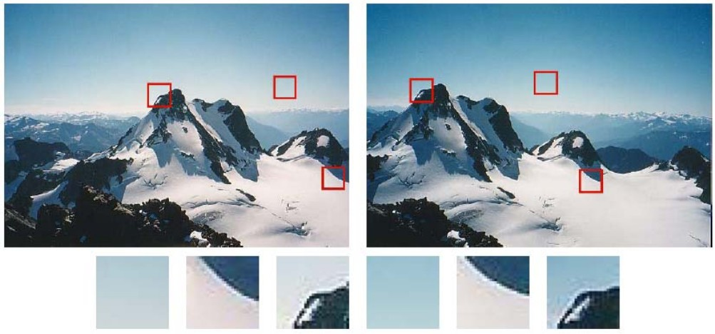
Some patches can be localized or matched with higher accuracy than others.
Interest points
Local Image Features

Slide 17

Contents
1
Feature Matching
What are Interest Points?
Interest point detection
Harris Interest Point Detector
Eigen Vectors and Eigen Values
Local Image Features

Slide 18
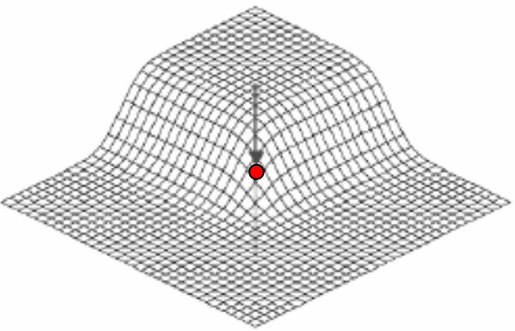
Interest point detection
Expressive texture
The point at which the direction of the boundary of object changes abruptly
Intersection point between two or more edge segments
Local Image Features

Slide 19
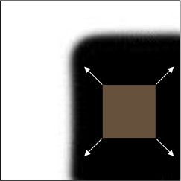
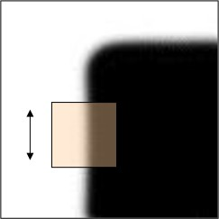
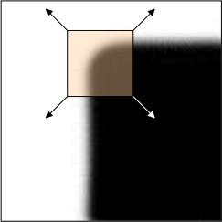
Interest point detection
We should easily recognize the point by looking through a small window
Shifting a window in any direction should give a large change in intensity
(a) (b) (c)
Table: (a) flat region: no change in all directions. (b) edge: no change along the edge direction. (c) corner: significant change in all directions
Local Image Features

Slide 20
Interest point detection
Properties of interest points
Detect all (or most) true interest points No false interest points
Well localized.
Robust with respect to noise. Efficient detection
Local Image Features

Slide 21
Interest point detection
Corner detection approaches
Based on brightness of images
Usually image derivatives
Based on boundary extraction First step edge detection Curvature analysis of edges
Local Image Features

Slide 22
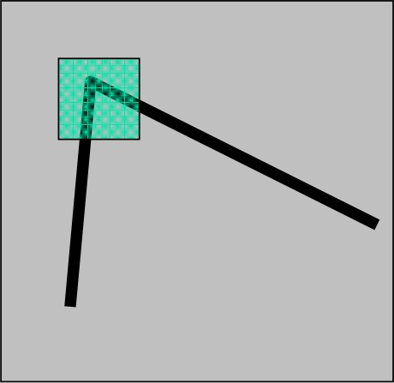
Interest point detection
Harris corner detector
Corner point can be recognized in a window
Shifting a window in any direction should give a large change in intensity
Figure: Reprinted from Harris, M. Stephens, 1988.
Local Image Features

Slide 23
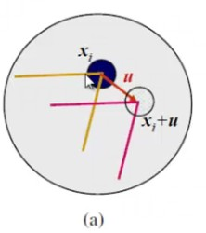
Interest point detection
Aperture Problem
Local Image Features

Slide 24
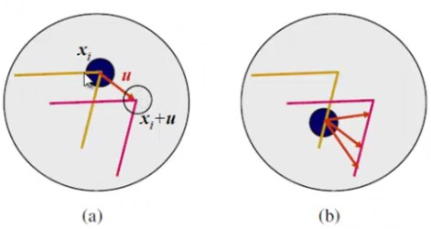
Interest point detection
Aperture Problem
Local Image Features

Slide 25
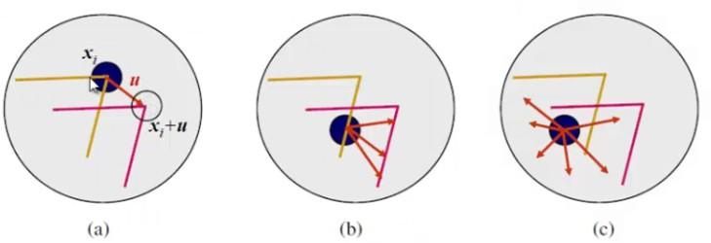
Interest point detection
Aperture Problem
Local Image Features

Slide 26

Contents
1
Feature Matching
What are Interest Points?
Interest point detection
Harris Interest Point Detector
Eigen Vectors and Eigen Values
Local Image Features

Slide 27
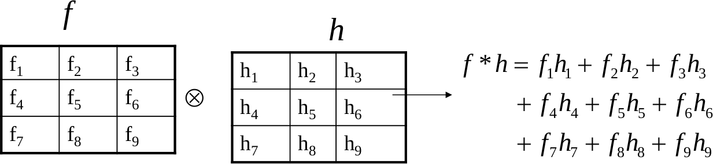
Harris Interest Point Detector
Correlation
Σ Σ
f ⊗ h =
f (k, l )h(i + k, j + l )
k j
f = Image
h = Kernel
Local Image Features

Slide 28
Harris Interest Point Detector
Cross and Auto correlation vs SSD
Cross Correlation
Σ Σ
f ⊗ h =
f (k, l )h(i + k, j + l )
k l
Auto Correlation
Σ Σ
f ⊗ h =
f (k, l )f (i + k, j + l )
k l
Sum of Square Differences (SSD)
Σ Σ
SSD = (f (k, l ) − h(i + k, j + l ))
2
k l
Local Image Features

Slide 29
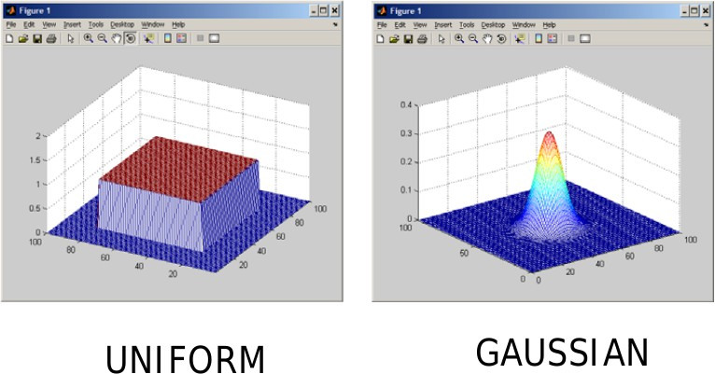
Harris Interest Point Detector
Change of intensity for the shift (u,v ) based on auto correlation.
Σ
E (u, v ) = w (x, y ) [I(x + u, y + v ) − I(x, y )]
2
x,y
Window function
Local Image Features

Slide 30
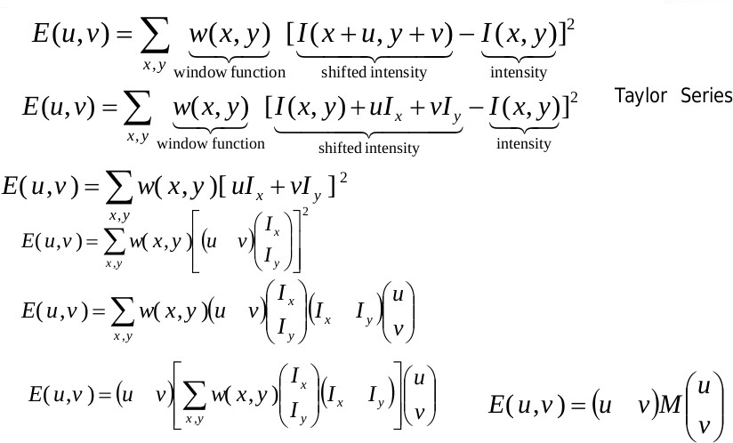
Harris Interest Point Detector
Slide Source: Mubarak Shah
Local Image Features

Slide 31
Mathematics of Harris Interest Point Detector
u
E (u, v ) = u v M
v
where,
Σ
I I I I
M = w (x, y )
x x
x y
I_{x} I_{y}
I_{y} I_{y}
x,y
We can write the equation without weight
I I I I
Σ
I
M =
Σ
x x
Σ
x y
=
x
I I_{y} = ^{Σ} ∇I(∇I)^{T}
I_{x} I_{y} I_{y} I_{y}
I_{y}
x
Local Image Features

Slide 32
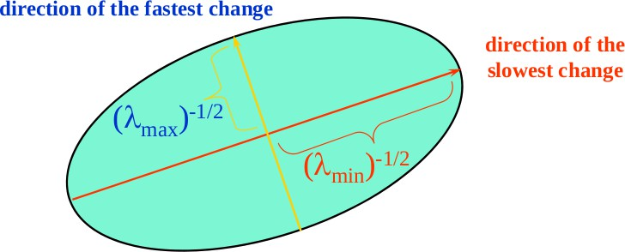
Mathematics of Harris Interest Point Detector
u
E (u, v ) = u v M
v
where,
Σ
2
I I I
M = w (x, y )
x
x y
2
I_{x} I_{y} I_{y}
x,y
E (u, v ) is an equation of an ellipse, where M is the covariance. Let λ₁ and λ₂ be eigenvalues of M
Local Image Features

Slide 33
Mathematics of Harris Interest Point Detector
u
E (u, v ) = u v M
v
where,
Σ
I
2
x
I I
λ 0
M = w (x, y )
x y
=
1
2
I_{x} I_{y} I_{y}
0 λ₂
x,y
Local Image Features

Slide 34
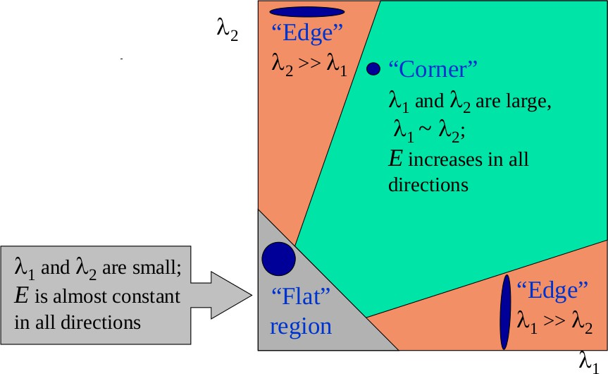
Classification of image points using eigenvalues of M:
Harris Interest Point Detector
Local Image Features

Slide 35
Harris Interest Point Detector
Measure of cornerness in terms of λ₁ , λ₂
λ 0
M =
1
0 λ₂
R = det(M) − k[trace(M)]²
R = λ₁λ₂ − k(λ₁ + λ₂)²
where k is a constant ranges 0.04 to 0.06.
Local Image Features

Slide 36
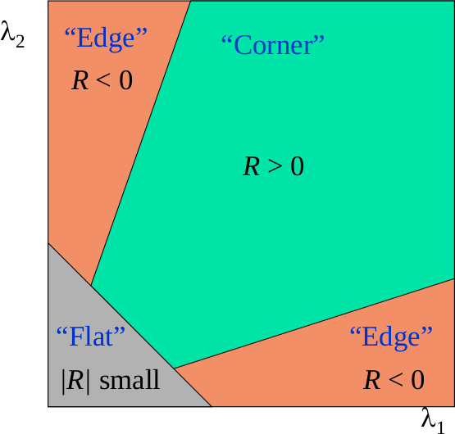
Harris Interest Point Detector
R is large for the interest point.
R is negative with large magnitude for an edge.
|R| is small for a flat region.
Local Image Features

Slide 37
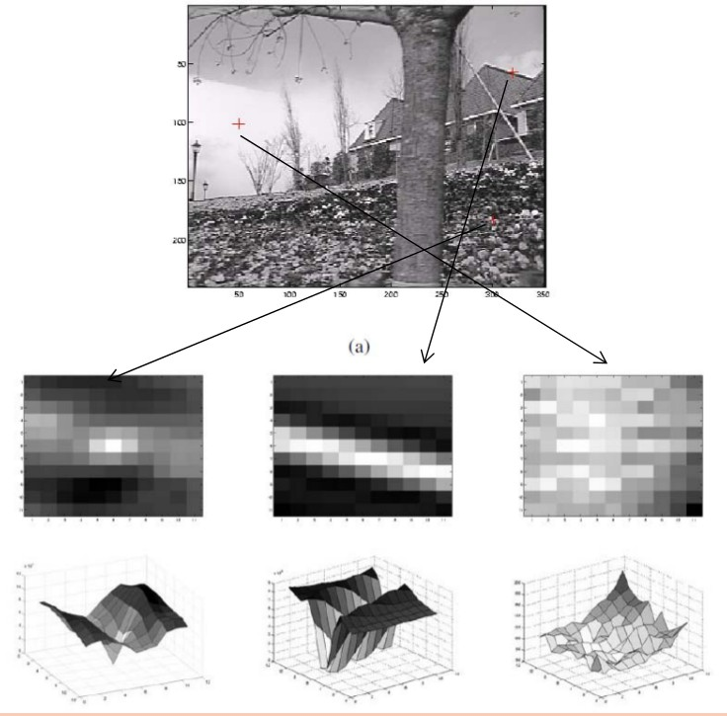
Harris Interest Point Detector
Figure: (a) Interest point, (b) Edges, and (c) flat region.
Local Image Features

Slide 38
Harris Interest Point Detector
Algorithm
Compute horizontal and vertical derivatives I_{x} and I_{y} of the image.
Compute three images corresponding to three terms I² , I² , and I_{x} I_{y}
x y
in matrix M.
Convolve the three images with a larger Gaussian filter. Compute scalar cornerness value using one of the R measures.
Find local maxima above some threshold as detected interest points.
Local Image Features

Slide 39
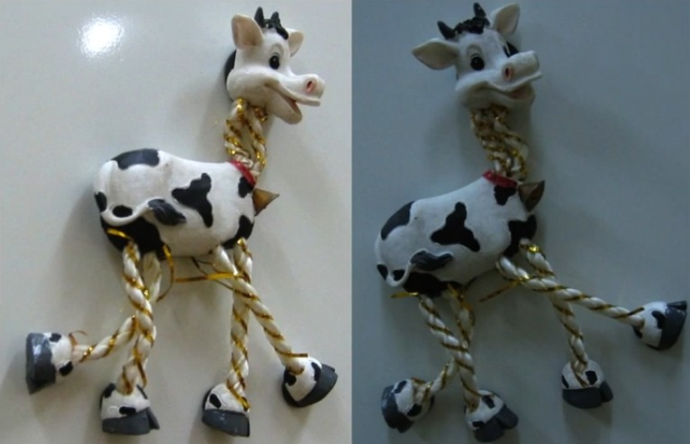
Harris Interest Point Detector
Consider a toy giraffe to apply Harris algorithm.
Local Image Features

Slide 40
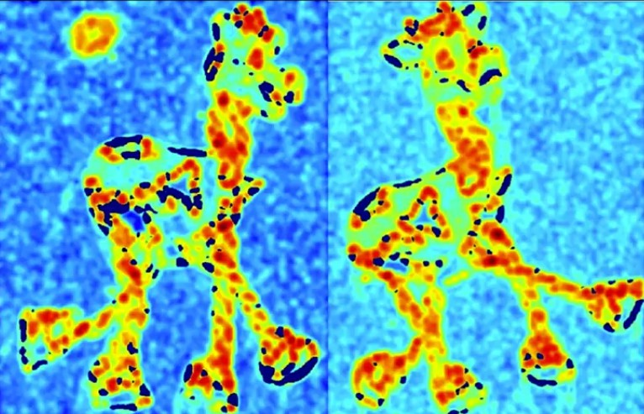
Harris Interest Point Detector
Compute corner response R.
Local Image Features

Slide 41
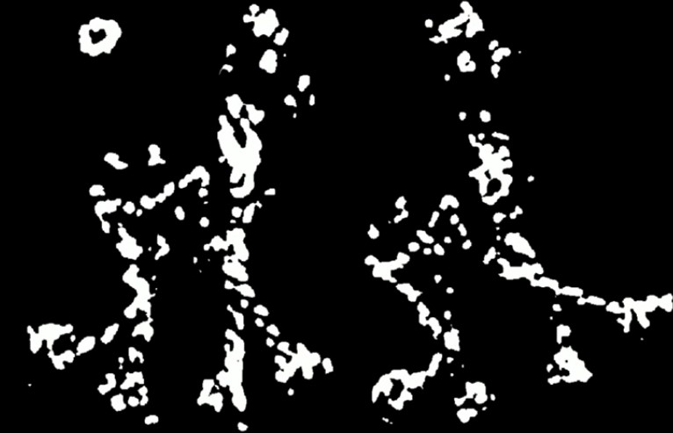
Find points with larger corner response R > threshold.
Harris Interest Point Detector
Local Image Features

Slide 42
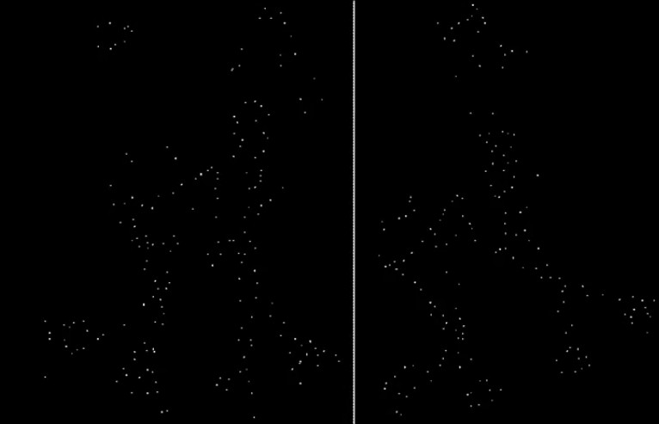
Harris Interest Point Detector
Take only the points of local maxima of R.
Local Image Features

Slide 43

Contents
1
Feature Matching
What are Interest Points?
Interest point detection
Harris Interest Point Detector
Eigen Vectors and Eigen Values
Local Image Features

Slide 44
Eigen Vectors and Eigen Values
The Eigen vector x of a matrix A is a special vector with the following property
Ax = λx
Local Image Features

Slide 45
The End

